Slide 1


Hotel Aggregator

Slide 2


CONTENTS
Project
Problem
Process
Insights
Summary

Slide 3


R
The project aims to analyze a dataset of hotel aggregator listings using power-bi.
The objective is to gain insights on the following
Geographical distribution
Pricing
Availability
Host Performance
Review Scores
The project is to provide comprehensive insights to improve the quality and competitiveness of the listings
Project Overview

Slide 4


Problem
Over 50 datasets description with a lot of details
Understanding The listing dynamics
But how to capitalize on it when there is so much?
Analysis to enhance the performance of the listings

Slide 5

Process
1
Data Understanding
2
Data Cleaning
3
Data Modelling
4
Data Analysis
5
Uncover Insights

Slide 6
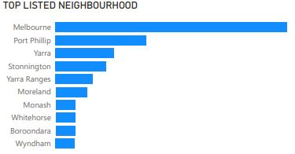
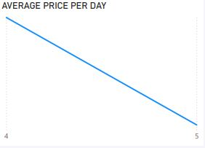
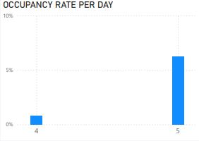
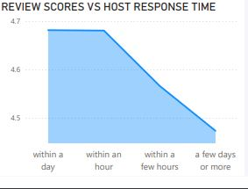
Insights

Slide 7
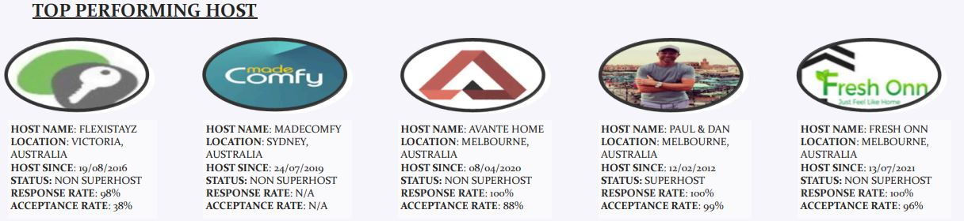
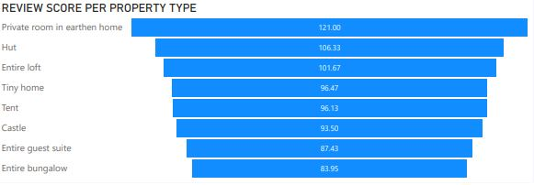
Insights

Slide 8


Yarra, Yarra Ranges, Port Phillip, Stonington, Moreland, Wyndham, Whitehorse, are one of the areas with high review concentration are top listed areas
Occupancy Rate was higher on 5th than 4th of September, Budget friendly prices increases the rate
Analysis shows host response rates affects listing, reason why best performing hosts tend to have more listings.
Casa Particular Property type has a very low review score with being the most priced type, others with low review score are shared rooms, private room in train. Improvements should be made within this specific property types.
Summary

Slide 9

Thank you!
ANY QUESTIONS?

